Slide 1
timsTOF Visualization App Tutorial

Slide 2
Getting Started

Slide 3
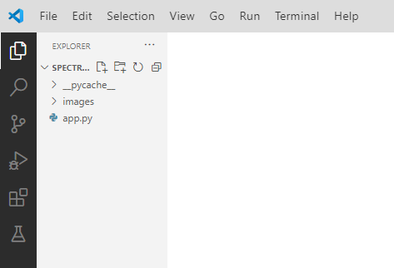
Getting started in Visual Studio Code
Set the directory containing the app.py file as the working directory
Open the app.py file by double-clicking on the file

Slide 4
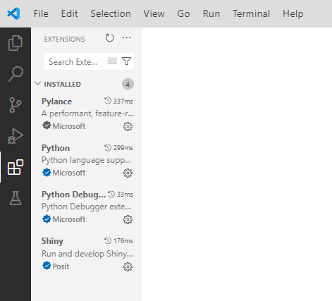
Install necessary extensions
Install Python and Shiny extensions using the Extensions:Marketplace tab

Slide 5
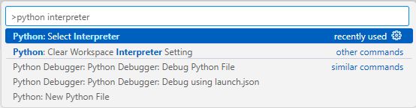
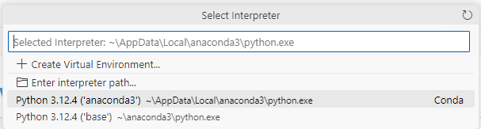
Set Python interpreter to current installation of Python/Anaconda
Ctrl+Shift+P and search Python interpreter
Select current Python installation

Slide 6
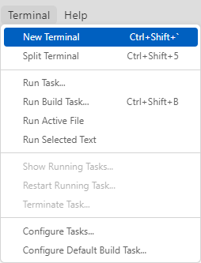
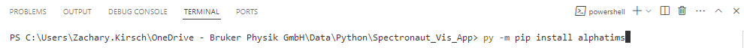
Installing necessary Python libraries
Open a new powershell terminal and use pip to install
alphatims, colorcet, faicons, hvplot, matplotlib-venn, scikit-learn, shiny, shinyswatch, and upsetplot
Replace the part underlined in red with the library to install

Slide 7
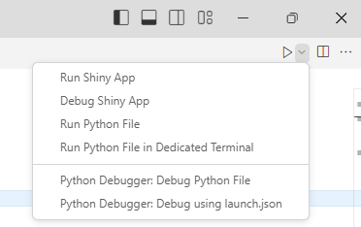
Starting the Shiny app
With the extensions and libraries installed, you should be able to run the app with Visual Studio Code recognizing it as a Shiny app

Slide 8
Using the App

Slide 9
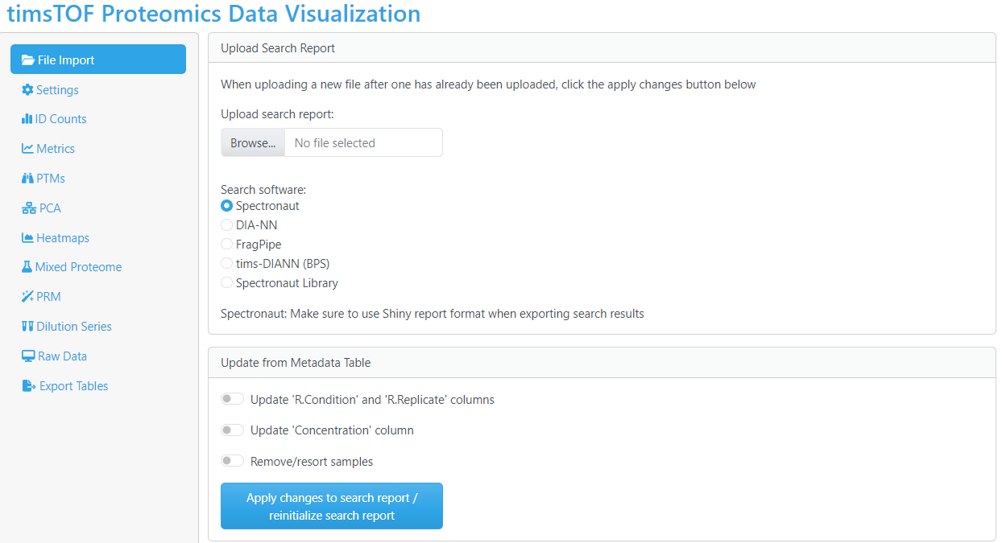
File import
Upload search report (.tsv)
Select search software

Slide 10
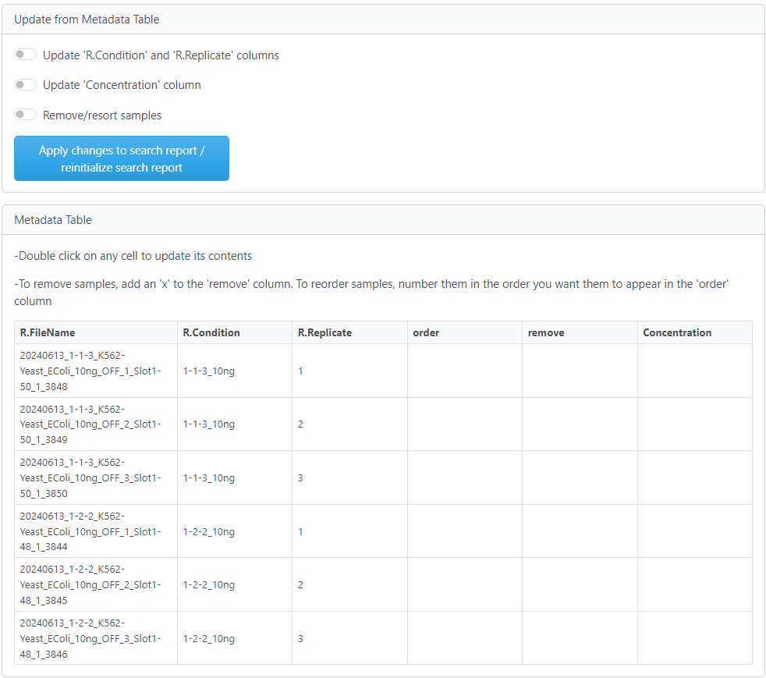
Updating result metadata
This is necessary when condition names are not native to the search report or if changes are needed for the order, presentation, or names of samples
If changes are made to the metadata table, use these switches to specify the change and then click the “apply changes” button
R.FileName: (required, autofilled)
Will be pre-filled from the report file.
R.Condition: (required)
Experimental condition names. If Condition was specified in Spectronaut, it will be added here. Otherwise, it needs to be filled out.
R.Replicate: (required)
Replicate numbers. Should be unique in each condition. . If Replicate was specified in Spectronaut, it will be added here. Otherwise, it needs to be filled out.
Order: (optional)
Specify the numerical order you want the runs shown in.
Remove: (optional)
Adding an ‘x’ means that you want to remove the run from the subsequent figures.
Concentration: (optional)
Should be the same value for each condition.

Slide 11
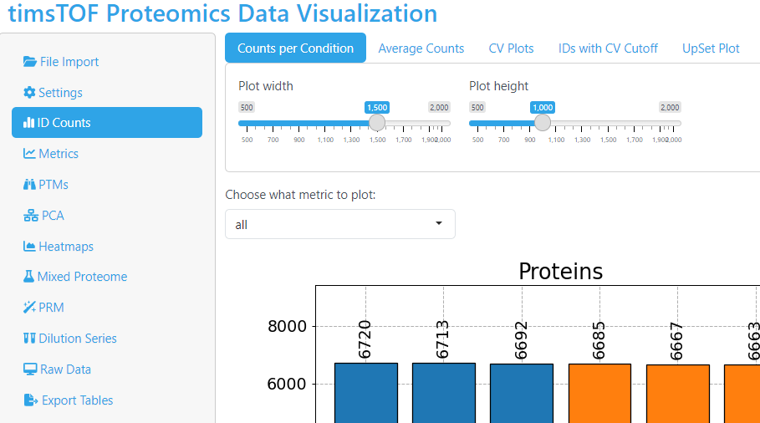
General Navigation
Main navigation pane organized by the types of information to be plotted
Sub-menu navigation organized by the different available plots that can be generated

Slide 12
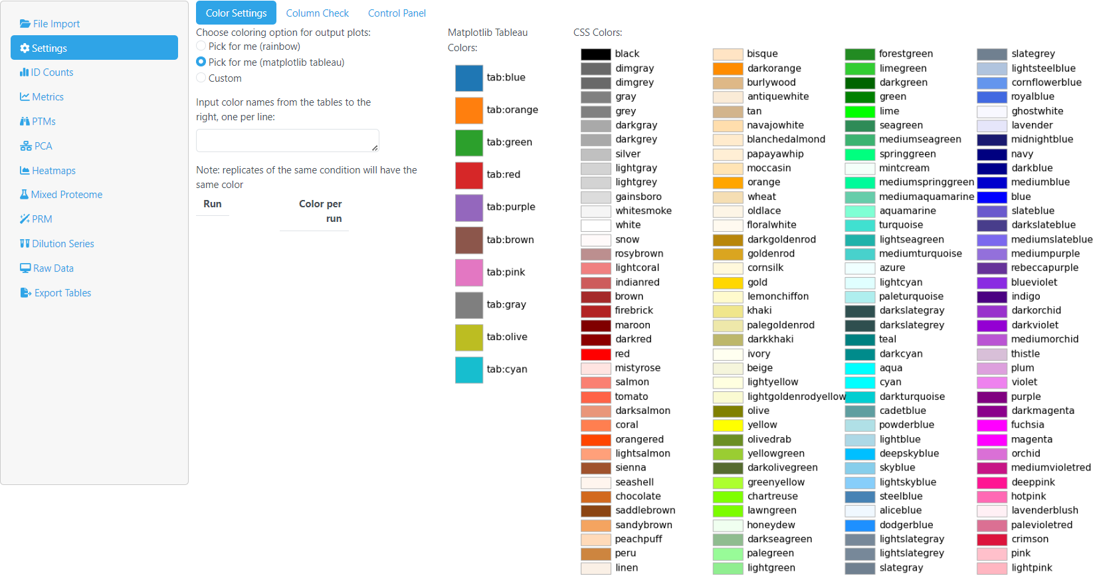
Coloring Options
Multiple color setting options for colors to be used in plotting
Can mix and match from those listed when using custom colors

Slide 13
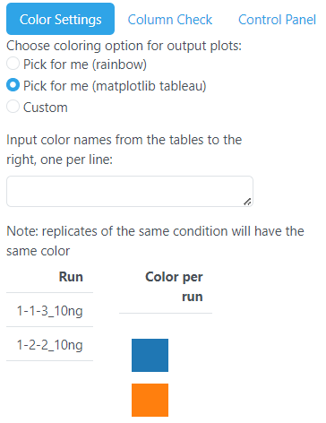
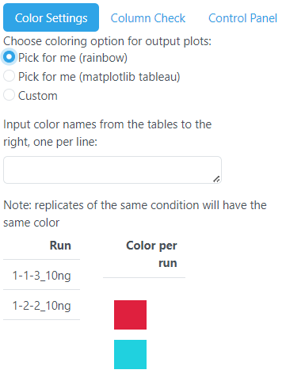
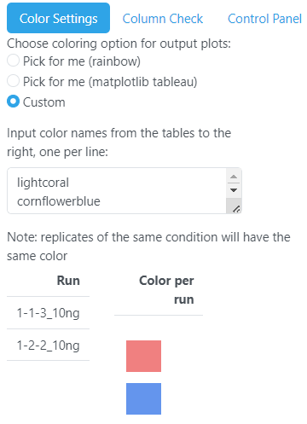
Coloring Options
Colors by condition according to a rainbow color series split based on the number of conditions
Colors by condition according to the matplotlib tableau colors
Colors by condition according to specified colors in the text area

Slide 14
File Import Formats

Slide 15
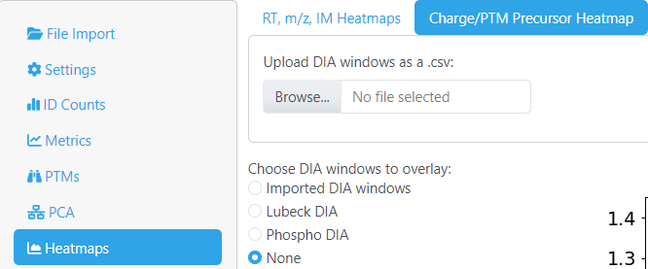
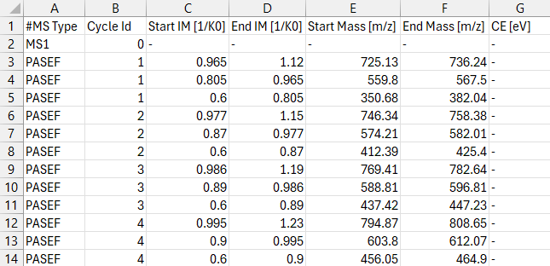
Uploading DIA windows to overlay
CSV Format:

Slide 16
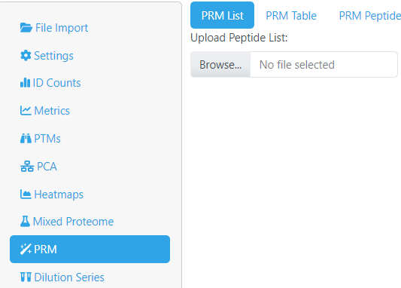
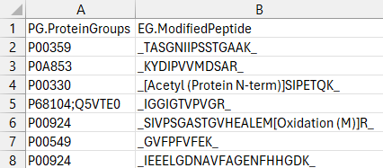
Uploading peptide list to track
CSV Format:

Slide 17
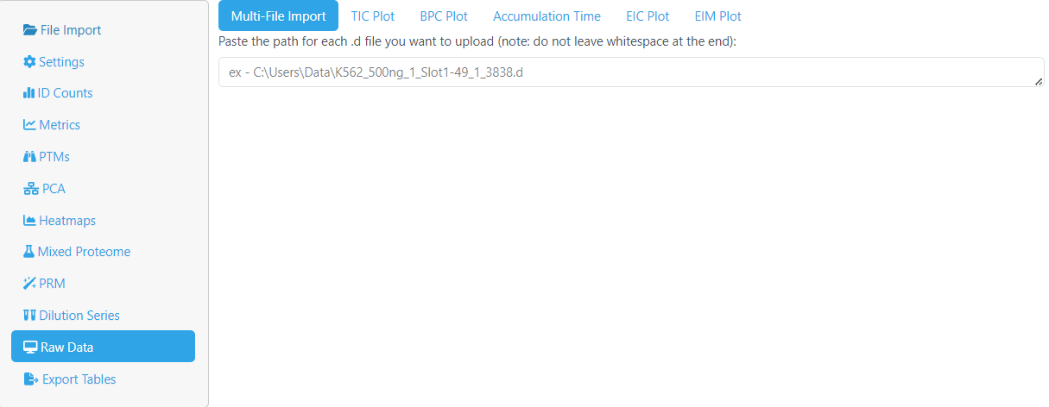
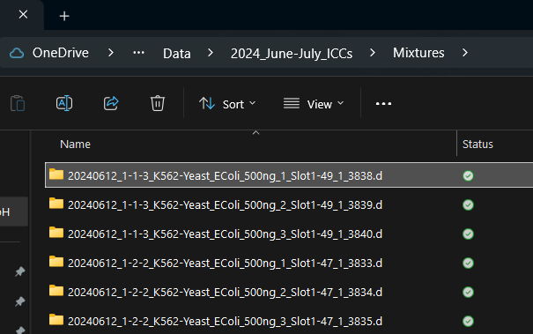
Referencing raw data files
Paste the full path of the .d folder for each file you want to plot into the text area
Should look like the example text shown

